Slide 1

Programming and Data Structures
Debasis Samanta
Computer Science & Engineering
Indian Institute of Technology Kharagpur
Spring-2017

Slide 2
Today’s discussion…
Flowchart : Basic Concepts
  Some examples
Control of Flows in C Language
  Sequence
  Decision
  Looping

Slide 3
Flowchart

Slide 4
Why Flowchart?
Program design is the foundation for a good program.
It is an important part of the program development cycle.
  Easy to modify at a later stage
  Easy to update
  Easy to debug
  Easy to understand by other
It enables a strategy to be used in writing programs

Slide 5
What is Flowchart?
It is a pictorial description of
problem solving strategy.
There are some basic elements for drawing it
  Start, Stop
  Input, Output
  Tasks
  Branching
  Looping
  Decision
  etc.

Slide 6
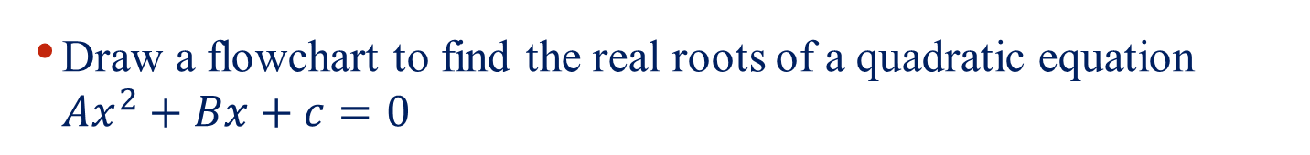
Example : Solving Quadratic Equations
Draw a flowchart to find the real roots of a quadratic equation $Ax^{2}+Bx+c=0$

Slide 7
Example : Finding the Largest
Read 10 positive numbers from the keyboard and print the largest value entered.

Slide 8
Control of Flows in C Language

Slide 9
Control of Flows in C Programs
There are three constructs in C language
    Sequence
      It indicates the order of execution of statements
    Branching (also called decision)
      It indicates if-then-else rule
    Looping (also called iteration)
      It allows to repeat some executions

Slide 10
Sequence in Programs

Slide 11
Sequence : Example
Given a flowchart, how many paths are
possible from Start to Stop nodes?

Slide 12
Statement
An expression followed by a semicolon (;) is called a statement.
Example
x=0;
i++;
printf(“The sum is %d\n",sum);
Block of statements
Braces { and } are used to group declerations and statements togather. Such a block of statement is also called “compound statement” or simply “block”.
Example
{
sum=sum+count;
count++;
printf(“sum = %d\n",sum);
}
Usually { and } are used to group multiple statements after an if, else, while, for, etc.

Slide 13
Statement…
A set of statements and/or blocks are executed in the order they appear in programs are called a sequence.
Example
Sequence 1 | Sequence 2
x=5; y=3; x=x+y; y=x+y; printf(“%d %d”, x,y); | x=5; y=3; y=x+y; x=x+y; printf(“%d %d”, x,y);
Are the two sequences give the same result?

Slide 14
Branching in Programs

Slide 15
Branching: Example

Slide 16
Branching
Branching (also called decision ) allows different set of instructions to be executed depending on the outcome of logical test.
The if-else statement is used to express decision.
  The syntax in C language is
if (logical test)
else
block 1
block 2

Slide 17
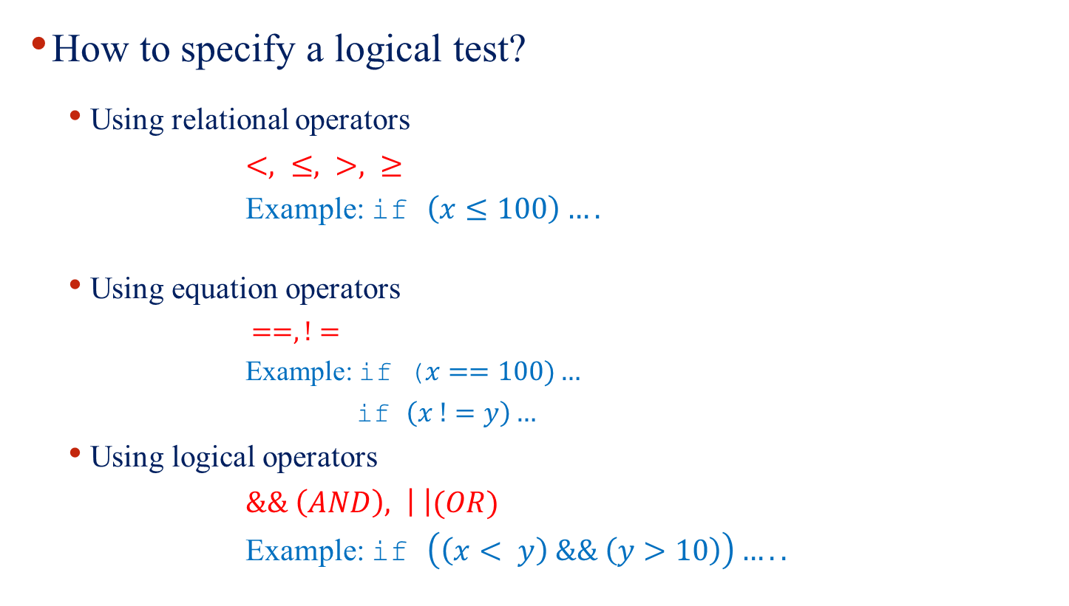
Logical Test
How to specify a logical test?
  Using relational operators
  $<, ≤, >, ≥$
  Example: if $\left(x≤100\right)….$
  Using equation operators
    $==, !=$
    Example: if ($x==100)…$
    if $\left(x !=y\right)…$
  Using logical operators
  $\&\& \left(AND\right), \left| \right|(OR)$
  Example: if $\left(\left(x< y\right) \&\& \left(y>10\right)\right)…..$

Slide 18
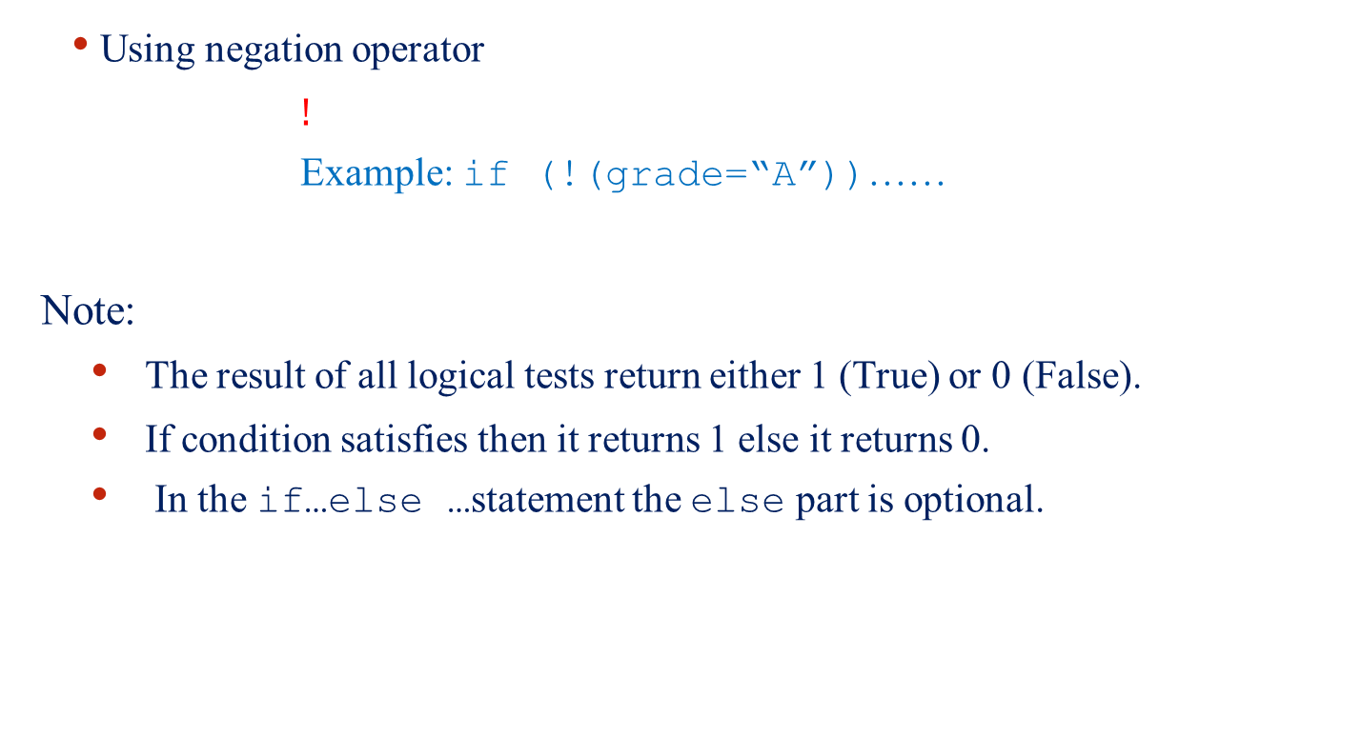
Logical Test
  Using negation operator
  $!$
  Example: if (!(grade=“A”))……
Note:
  The result of all logical tests return either 1 (True) or 0 (False).
  If condition satisfies then it returns 1 else it returns 0.
  In the if…else …statement the else part is optional.

Slide 19
Example
# include<stdio.h>
char sex;
int age;
main()
{
scanf(“%c”,&sex);
scanf(“%d”,&age);
if((sex==‘F’)&&(age<21))
printf(//…………);
else
printf(//…………);
}

Slide 20
Example
#include <stdio.h>
void main()
{
int x, y;
scanf(“%d%d”,&x,&y);
if (x>y)
printf(//…………);
else
printf(//…………);
}

Slide 21
Example
?

Slide 22
Example
void main()
{
int x, y, z;
scanf(“%d %d %d”,&x,&y,&z);
if(x>y)
max=x;
else
max=y;
if(max>z)
printf(“%d”,max)
else
printf(“%d”,z);
}

Slide 23
Nesting of if-else Statement
It is possible to nest if-else statements one within another
Example:
If (condition 1)
if(condition 2)
……
if(condition n)
else
else
else
Block 1
Block 2
Block n
Block 2
Block 1

Slide 24
Nesting of if else statement
Problem may arise if all “if” statement may not have “else” part
Example:
If (condition 1)
//statement(s)
else 1 if(condition 2)
//statement(s)
2 if(condition 3)
//statement(s)
//statement(s)
This else belongs to which if (1) or (2)?
else

Slide 25

Nesting of if else statement
Dangling else problem : Rule to resolve the ambiguity
An else clause is associated with the closest preceding unmatched if.
Example
$$if\left(exp1\right) if\left(exp2\right) statement1 else statement2$$
Which one should be the correct interpretation!
If (exp1) { if(exp2) statement1; else statement2; } | If (exp1) { if(exp2) statement1; } else statement2;

Slide 26
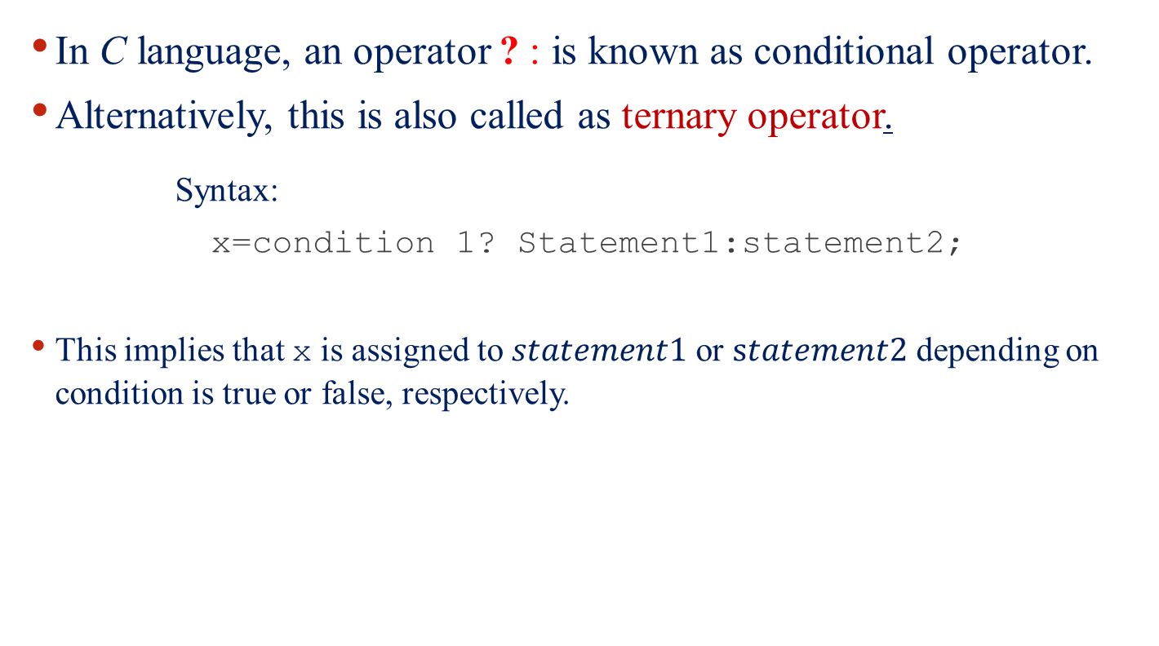
Conditional Operator ?:
In C language, an operator ? : is known as conditional operator.
Alternatively, this is also called as ternary operator.
Syntax:
x=condition 1? Statement1:statement2;
This implies that x is assigned to $statement1$ or $statement2$ depending on condition is true or false, respectively.

Slide 27
Conditional Operator ?:
Example
interest=(balance>5000)? balance×0.15 : balance×0.10;
This is equivalent to:
if =(balance>5000)
interest= balance×0.15;
else
interest= balance×0.10;

Slide 28
Switch Statement
The switch statement is a multi-way decision that tests whether an expression matches one of a number of constant integer values or branches accordingly.
Syntax:
Switch statement is used to select a particular statement from a group of alternative statement(s).
Here, expression should evaluate to an int value or char
These are either integer constant or character
switch (expression) {
case const1: statement1
case const2: statement2
…………………
…………………
default: statement

Slide 29
Example
You ask your user to type any alphabet in the keyboard. Read it as letter.
char letter;
switch(letter){
case ‘A’:
printf(“First letter %c\n”, letter);
break;
case ‘Z’:
printf(“Last letter %c\n”, letter);
break;
default:
printf(“Your letter %c\n”, letter);
break;
}
Note: The use of break statement
Will print this for all letters other than A and Z

Slide 30
Example
switch(choice = getchar()){
case ‘r’:
case ‘R’:
printf(“Red”);
break;
case ‘b’:
case ‘B’:
printf(“Blue”);
break;
case ‘g’:
case ‘G’:
printf(“Green”);
break;
default:
printf(“Black\n”);
}

Slide 31
Example
switch(choice=getchar()){
case ‘r’:
case ‘R’:
printf(“Red”);
case ‘b’:
case ‘B’:
printf(“Blue”);
case ‘g’:
case ‘G’:
printf(“Green”);
default:
printf(“Black\n”);
}
Since there is no break statement, the control passes to the next statement without checking the another option.

Slide 32
Looping in C Programs

Slide 33
Looping : Example

Slide 34
Looping : Repeated Execution
Loop: Group of instructions that are executed repeatedly while some condition remains true.
How loops are controlled
Condition
controlled
Sentinel
controlled
Counter controlled

Slide 35
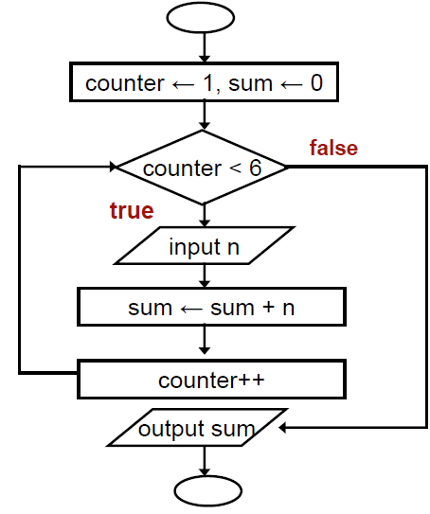
Counter Controlled Loop
Read 5 integers and display the value of their summation.

Slide 36
Condition Controlled Loop
Given an exam marks as input, display the appropriate
message based on the rules below:
If marks is greater than 49, display “PASS”, otherwise display “FAIL”
However, for input outside the 0-100 range, display “WRONG INPUT” and prompt the user to input again until a valid input is entered

Slide 37
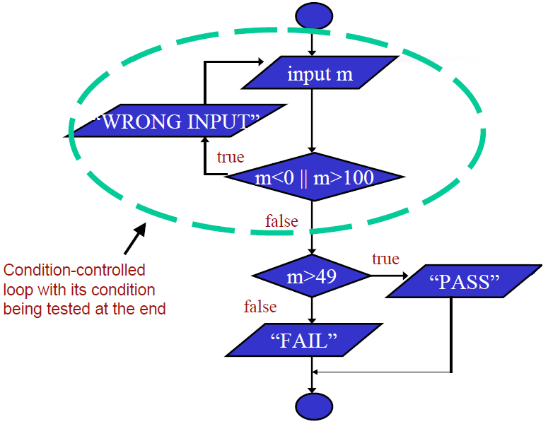
Condition Controlled Loop

Slide 38
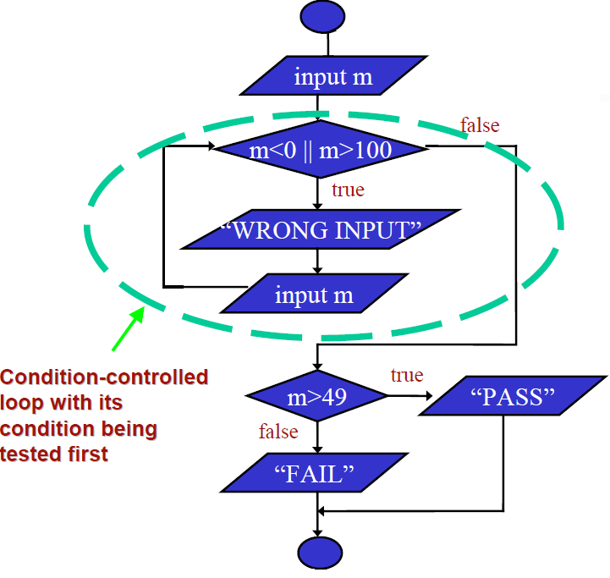
Condition Controlled Loop

Slide 39
Sentinel-Controlled Loop
Receive a number of positive
integers and display the summation and average of these integers.
A negative or zero input indicates the end of input process
Input: A set of integers
ending with a
negative integer or a zero
Output: Summation and
Average of these integers

Slide 40
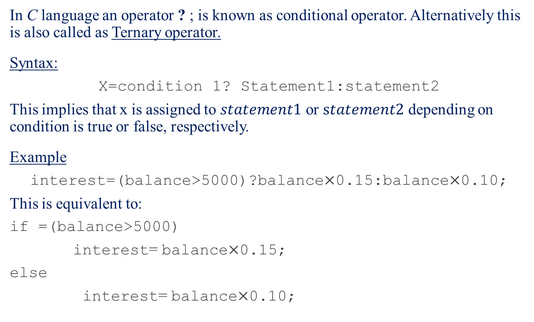
Sentinel-Controlled Loop
Sentinel
Value
Input Example:
$$30 16 42 −9$$
Output Example:
$$Sum = 88$$
$$Average = 29.33$$

Slide 41
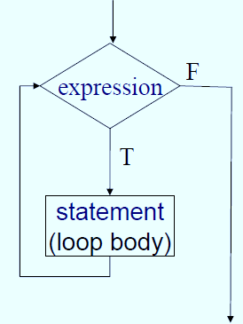
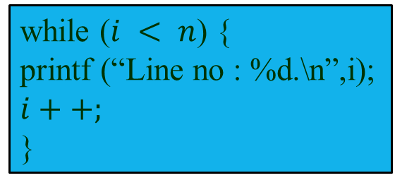
while Loop
while (expression)
statement
while ($i < n$) {
printf (“Line no : %d.\n”,i);
$i++;$
}

Slide 42
while Statement
The “while” statement is used to carry out looping operations, in which a group of statements is executed repeatedly, as long as some condition remains satisfied.
while (condition)
statement (s);
while (condition) {
statement_1;
...
statement_N;
}
Note:
The while-loop will not be entered if the loop-control expression evaluates to false (zero) even before the first iteration.
break can be used to come out of the while loop.

Slide 43
while : Example
int weight;
while ( weight > 65 ) {
printf ("Go, exercise, ");
printf ("then come back. \n");
printf ("Enter your weight: ");
scanf ("%d", &weight);
}

Slide 44
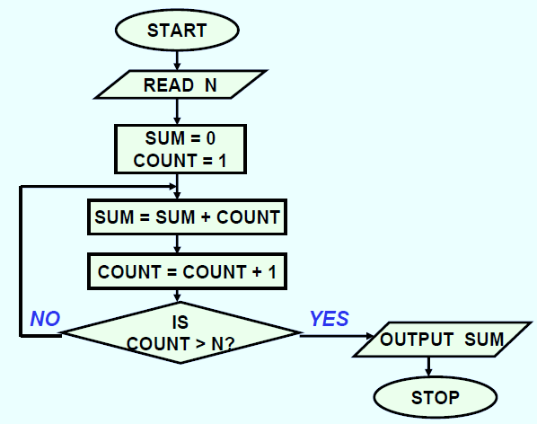
Sum of First N Natural Numbers
int main () {
int N, count, sum;
scanf (“%d”, &N) ;
sum = 0;
count = 1;
while (count <= N) {
sum = sum + count;
count = count + 1; }
printf (“Sum =%d\n”, sum) ;
return 0; }

Slide 45
Double Your Money
Suppose your ₹ 10000 is earning interest at 1% per month. How many months until you double your money ?
my_money=10000.0;
n=0;
while(my_money < 20000.0) {
my_money = my_money*1.01;
n++;
}
printf(“My money will double in %d months.\n”,n);

Slide 46
Maximum of Inputs
printf (“Enter any positive numbers: to end enter -1.0\n”);
max = 0.0;
count = 0;
scanf(“%f”, &next);
while (next != -1.0) {
if (next > max)
max = next;
count++;
scanf(“%f”, &next);
}
printf (“The maximum number is %f\n”, max) ;

Slide 47
Printing a 2-D Figure
How would you print the following diagram?
* * * * *
* * * * *
* * * * *
repeat 3 times
repeat 5 times
print *
print a row of 5 stars

Slide 48
Nested Loops
#define ROWS 3
#define COLS 5
…
row =1;
while (row <= ROWS) {
/* print a row of 5 *’s */
row++;
}
row=1;
while (row <= ROWS) {
col=1;
while (col <= COLS) {
printf (“*“);
col++;
}
printf(“\n”);
row++;
}
outer
loop
inner
loop

Slide 49
Printing a 2-D Figure
How would you print the following Pascal triangle?
*
* * *
* * * * *
* * * * * * *

Slide 50
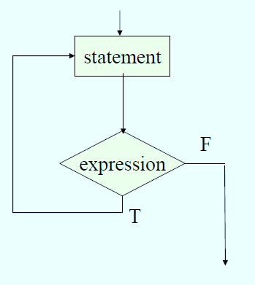
do-while Statement
do statement while (expression)
main () {
int digit=0;
do
printf(“%d\n”,digit++);
while (digit <= 9) ;
}

Slide 51
Example: do-while
Usage: Prompt user to input “month” value,
Keep prompting until a correct value of moth is input.
…
do {
printf (“Please input month {1-12}”);
scanf (“%d”, &month);
}
while ((month < 1) || (month > 12));

Slide 52
Example: do-while
Usage: Prompt user to input any character
Display the character
Keep prompting until the Return key is placed.
…
int main ()
{
char echo ;
do {
scanf (“%c”, &echo);
printf (“%c”,echo);
} while (echo != ‘\n’) ;
}

Slide 53
for Statement
The “for” statement is the most commonly used looping
structure in C.
General syntax:
for ( expr1; expr2; expr3) statement;
expr1 (init) : initialize parameters
expr2 (test): test condition, loop continues if satisfied
expr3 (update): used to alter the value of the parameters
after each iteration
statement (body): body of the loop

Slide 54
for(…) Statement
for (expr1;expr2;expr3) {
statement
}
int i;
for (i=1; i < 100; i += 2;) {
printf(“%d\t”,i);
}

Slide 55
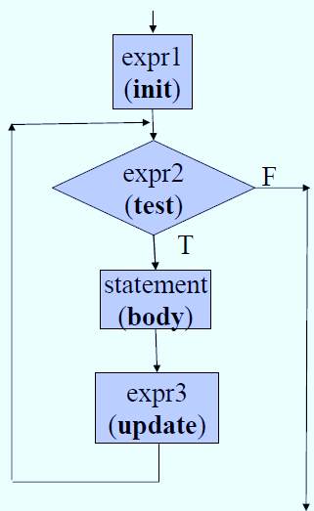
for(…) versus while (…)
for (expr1;expr2;expr3) {
statement
}
expr1;
while (expr2) {
statement
expr3;
}

Slide 56
Sum of First N Natural Numbers
int main () {
int N, count, sum;
scanf (“%d”, &N) ;
sum = 0;
count = 1;
while (count <= N) {
sum = sum + count;
count = count + 1;
}
printf (“Sum = %d\n”, sum) ;
return 0;
}

Slide 57
Sum of First N Natural numbers
int main () {
int N, count, sum;
scanf (“%d”, &N) ;
sum = 0;
count = 1;
while (count <= N) {
sum = sum + count;
count = count + 1;
}
printf (“Sum = %d\n”, sum) ;
return 0;
}
int main () {
int N, count, sum;
scanf (“%d”, &N) ;
sum = 0;
for (count=1; count <= N; count++)
sum = sum + count;
printf (“Sum = %d\n”, sum) ;
return 0;
}

Slide 58
2-D Figure
Print
* * * * *
* * * * *
* * * * *
#define ROWS 3
#define COLS 5
....
for (row=1; row<=ROWS;row++) {
for (col=1; col<=COLS; col++) {
printf(“*”);
}
printf(“\n”);
}

Slide 59
Another 2-D Figure
Print
*
* *
* * *
* * * *
* * * * *
#define ROWS 5
....
int row, col;
for (row=1;row<=ROWS;row++) {
for(col=1;col<=row;col++) {
printf(“* ”);
}
printf(“\n”);
}

Slide 60
for - Examples
Problem 1: Write a For statement that computes the sum of all odd
numbers between 1000 and 2000.
Problem 2: Write a For statement that computes the sum of all
numbers between 1000 and 10000 that are divisible by 17.
Problem 3: Printing square problem but this time make the square
hollow.
Problem 4: Print
* * * * *
* * * *
* * *
* *
*

Slide 61
Problem 4 : solution
Print
* * * * *
* * * *
* * *
* *
*
#define ROWS 5
....
int row, col;
for (row=0; row<ROWS; row++) {
for (col=1; col<=row; col++)
printf(" ");
for (col=1; col<=ROWS-row; col++)
printf("* ");
printf ("\n");
}

Slide 62
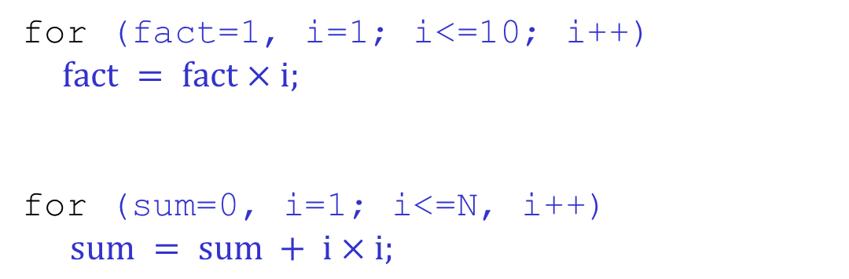
The comma operator
We can give several statements separated by commas in place of “expression1”, “expression2”, and “expression3”.
for (fact=1, i=1; i<=10; i++)
$fact = fact×i;$
for (sum=0, i=1; i<=N, i++)
$sum = sum + i×i;$

Slide 63
for :: Some Observations
Arithmetic expressions
  Initialization, loop-continuation, and increment can contain arithmetic expressions.
for ( k = x; k <= 4 * x * y; k += y / x )
  "Increment" may be negative (decrement)
for (digit=9; digit>=0; digit--)
  If loop continuation condition initially false:
    Body of for structure not performed.
    Control proceeds with statement after for structure.

Slide 64
Specifying “Infinite Loop”
while (1) {
statements
}
for (; ;)
{
statements
}
do {
statements
} while (1);

Slide 65
The break Statement
Break out of the loop { }
  can use with
    while
    do while
    for
    switch
  does not work with
    if
    else
Causes immediate exit from a while, do/while, for or switch structure.
Program execution continues with the first statement after the structure.

Slide 66
An Example
#include <stdio.h>
int main() {
int fact, i;
fact = 1; i = 1;
while ( i<10 ) {
/* run loop –break when fact >100*/
fact = fact * i;
if ( fact > 100 ) {
printf ("Factorial of %d above 100", i);
break;
/* break out of the while loop */
}
i++ ;
}
}

Slide 67
The continue Statement
Skips the remaining statements in the body of a
while, for or do/while structure.
  Proceeds with the next iteration of the loop.
while and do/while
  Loop-continuation test is evaluated immediately after the continue statement is executed.
for structure
  expression3 is evaluated, then expression2 is evaluated.

Slide 68
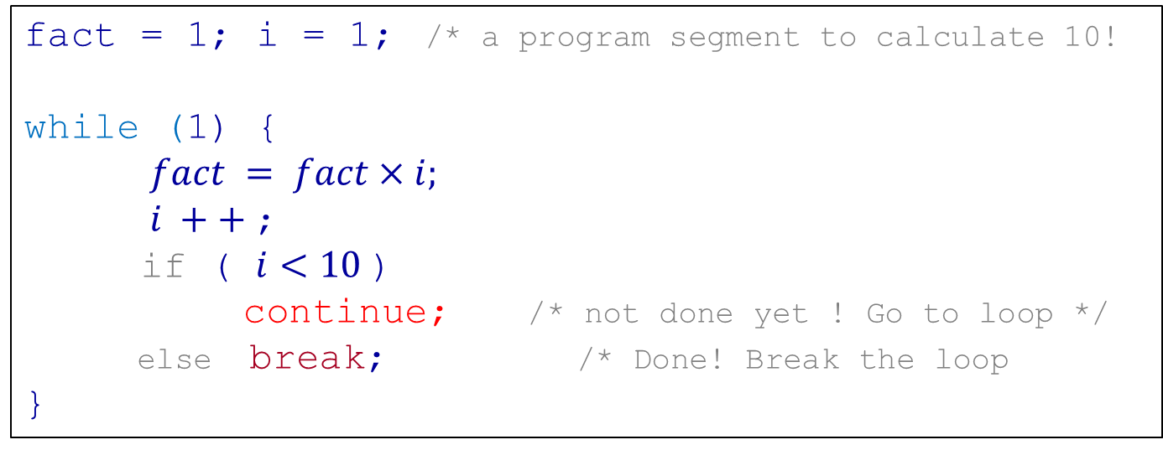
Example with break & continue
fact = 1; i = 1; /* a program segment to calculate 10!
while (1) {
$fact = fact×i;$
$i ++$;
if ( $i<10$)
continue; /* not done yet ! Go to loop */
else break; /* Done! Break the loop
}

Slide 69

Any question?
  You may post your question(s) at the “Discussion Forum” maintained in the course Web page.

Slide 70
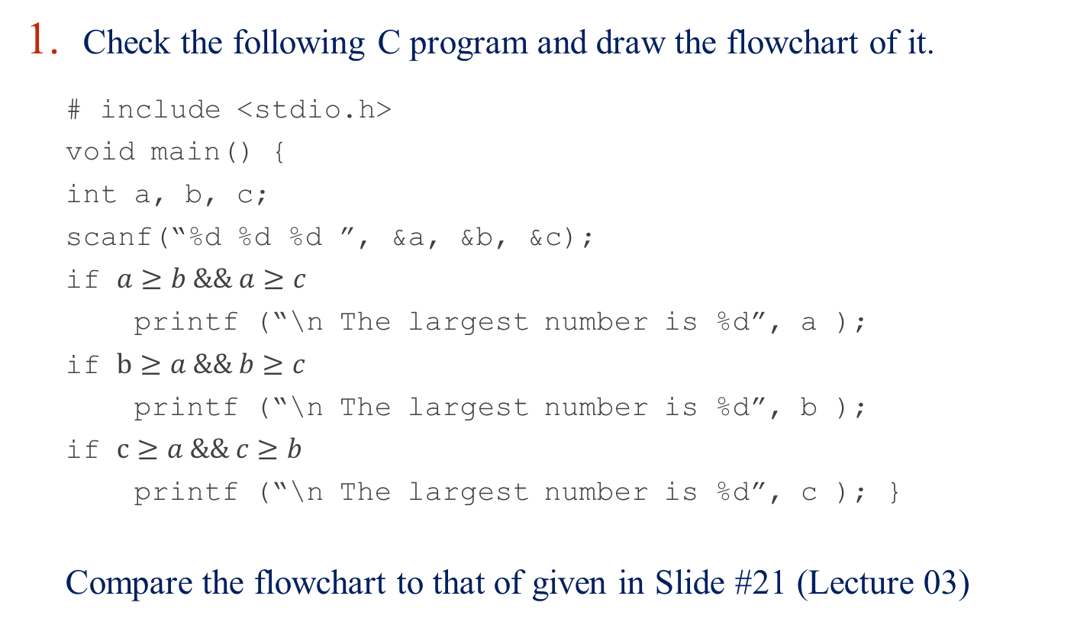
Problems to Ponder
Check the following C program and draw the flowchart of it.
  # include <stdio.h>
  void main() {
  int a, b, c;
  scanf(“%d %d %d ”, &a, &b, &c);
  if $a≥b \&\& a≥c$
  printf (“\n The largest number is %d”, a );
  if $b≥a \&\& b≥c$
  printf (“\n The largest number is %d”, b );
  if $c≥a \&\& c≥b$
  printf (“\n The largest number is %d”, c ); }
  Compare the flowchart to that of given in Slide #21 (Lecture 03)

Slide 71
Problems to Ponder
Are the following two code fragments give same result?
Code 1:
if (section==4)
printf(“you are in section 4”);
Code 2:
if (section=4)
printf(“you are in section 4”);
  Suppose, the value of section is 4.

Slide 72
Problems to Ponder
  What will be the output of the following code segment. You should assume suitable values of the variables and then give your answer.
    if(n>0)
    if(a>b)
    z=a;
    else z=b;
    ……………

Slide 73

Problems to Ponder
Resolve the dangling else problem in the following pieces of C codes.
    if $e_{1}$ $s_{1}$
    else if $e_{2}$ $s_{2}$
    if $e_{1}$ $s_{1}$
    else if $e_{2}$ $s_{2}$
    else $s_{3}$
    if $e_{1}$ if $e_{2}$ $s_{1}$
    else $s_{2}$
    else $s_{3}$
    if $e_{1}$ if $e_{2}$ $s_{1}$
    else $s_{2}$
    Note: $e_{1}$, $e_{2}, e_{3}…………$ denotes logical test and $s_{1}$, $s_{2}, s_{3}…………$ denotes statement(s)

Slide 74
Problems to Ponder
Your program asks a user to type y or Y to select yes and n or N to select No. Which of the following code is correct to show the option selected by the user?
C=getchar();
If(c==‘y’)&&(c==‘Y’) printf(“Yes \n”);
else printf(“No \n”);
C=getchar();
If(c!=‘n’)||(c!=‘N’) printf(“Yes \n”);
else printf(“No \n”);

Slide 75
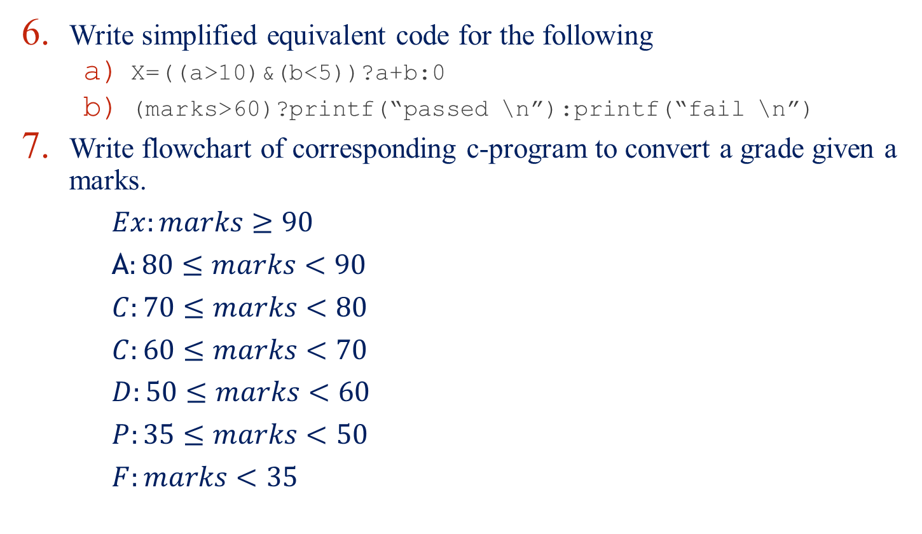
Problems to Ponder
Write simplified equivalent code for the following
    X=((a>10)&(b<5))?a+b:0
    (marks>60)?printf(“passed \n”):printf(“fail \n”)
Write flowchart of corresponding c-program to convert a grade given a marks.
$Ex:marks≥90$
A$:80≤marks<90$
$C:70≤marks<80$
$C:60≤marks<70$
$D:50≤marks<60$
$P:35≤marks<50$
$F:marks<35$

Slide 76
Problems to Ponder
a)
switch(letter){
case ‘A’:
printf(“First letter \n”);
case ‘Z’:
printf(“Last letter \n”);
break;
default:
printf(“Last letter \n”);
break;
}
b)
switch(letter){
case ‘A’:
printf(“First letter \n”);
break;
case ‘Z’:
printf(“Last letter \n”);
default:
printf(“Last letter \n”);
break;
}
c)
switch(letter){
case ‘A’:
printf(“First letter \n”);
case ‘Z’:
printf(“Last letter \n”);
default:
printf(“Last letter \n”);
}

Slide 77
Problems to ponder
How you can draw a flowchart depicting “switch” statement in C language.
What will be the equivalent code with for-statement for the following looping construct?
do { while (0) {
statement; statement;
} while (expr); }
What will be the execution of the following while statement?
while (5) {
statement;
}

Slide 78
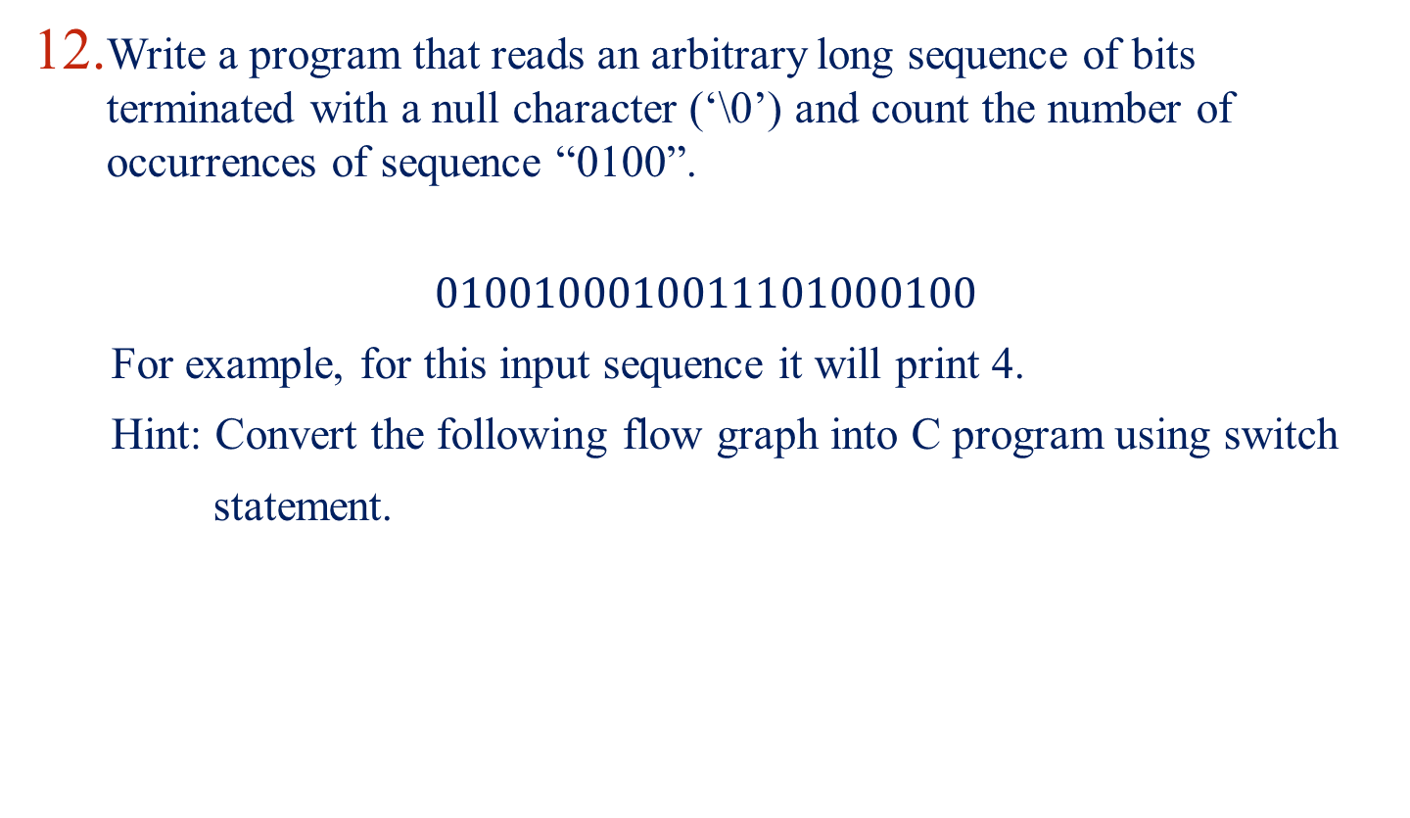
Problems to ponder
Write a program that reads an arbitrary long sequence of bits terminated with a null character (‘\0’) and count the number of occurrences of sequence “0100”.
$$0100100010011101000100$$
For example, for this input sequence it will print 4.
Hint: Convert the following flow graph into C program using switch
statement.

Slide 79
Problems for practice…
You can check the Moodle course management system for a set of problems for your own practice.
  Login to the Moodle system at cse.iitkgp.ac.in
  Select “PDS Spring-2017 (Theory) in the link “My Courses”
  Go to Topic 3: Practice Sheet #03 : C Programming Constructs
Solutions to the problems in Practice Sheet #03 will be uploaded in due time.

Slide 80
  If you try to solve problems yourself, then you will learn many things automatically.
  Spend few minutes and then enjoy the study.

